Slide 1
STACK

Slide 2

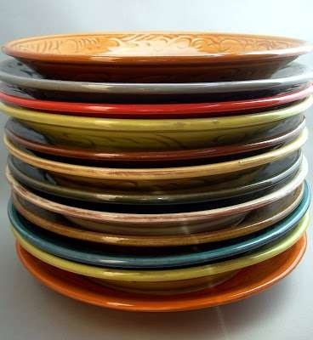
EXAMPLES OF STACK:

Slide 3
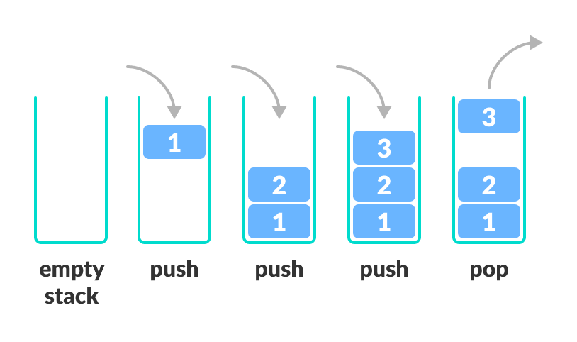
STACK: -Ordered List. -Insertion and Deletion takes place at one end called TOP of the stack. - LIFO (Last In First Out). Example: Arrangement of bangles, Pile of CDs.
Operations:
Push: Inserting element into the top of the stack
Pop: Deleting element from the top of the stack
Peek: Get the value of the top element without removing it
IsEmpty: Check if the stack is empty
IsFull: Check if the stack is full

Slide 4

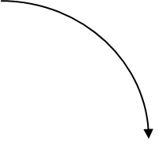
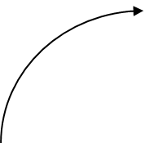





Stack
push()
pop()
top()

Slide 5
ARRAY BASED IMPLEMENTATION OF STACK Declaration: int stack[max],top=-1;
PUSH OPERATION:
void push(int x)
{
if(top==max-1)
cout<<"Stack is full: OVERFLOW";
else
{
top++;
stack[top]=x;
}
}

Slide 6
POP OPERATION:
int pop()
{
int item;
if(top==-1)
{
cout<<"Stack is empty:UNDERFLOW";
}
else
{
item=stack[top];
top--;
}
return item; }

Slide 7
LINKED LIST IMPLEMETATION OF STACK: struct stack { int data; struct stack* next; }*TOP=NULL,*pos=NULL;

Slide 8
LINKED LIST IMPLEMETATION OF STACK: PUSH OPERATION: void Push() { int value; struct stack* newnode; newnode=new stack(); cout<<"Enter Data:"; cin>>value; newnode->data=value; newnode->next=NULL; if(TOP==NULL) { TOP=newnode; pos=newnode; } else { newnode->next=TOP; TOP=newnode; } }

Slide 9
LINKED LIST IMPLEMETATION OF STACK: POP OPERATION: void pop() { struct stack* delnode; if(TOP==NULL) { cout<<"STACK IS EMPTY"; return; } else { pos=TOP; TOP=pos->next; delnode=pos; delete delnode; } }

Slide 10
DISPLAY ELEMENTS ON TOP OF STACK void display() { if(TOP==NULL) { cout<<"STACK IS EMPTY"; return; } else { for(pos=TOP;pos!=NULL;pos=pos->next) { cout<<pos->data; } } }

Slide 11
APPLICATIONS OF STACK: -Evaluation of expressions -Infix to postfix conversion. -Reversing list -Support an “undo” operation in an application -Function calls & recursion -Balancing parentheses -Depth first search -Decimal to Binary conversion -Backtracking

Slide 12
NOTATIONS OF ARITHMETIC EXPRESSIONS: -INFIX NOTATION A+B, (A+B)*C -PREFIX NOTATION(POLISH NOTATION) +AB, *+ABC -POSTFIX NOTATION(REVERSE POLISH NOTATION) AB+, AB+C* OPERATOR PRECEDENCE PRIORITY: 1.$ 2.^ 3. * ,/ 4.+ ,-

Slide 13
EVALUATION OF POSTFIX EXPRESSION USING STACK: -Read one character at a time,till end. -If the character is an operand,push its associated value into the stack. -If the character is an operator,POP two values from the stack,apply the operator to them and push the result onto stack.

Slide 14
EVALUATION OF POSTFIX EXPRESSION USING STACK:
STEPS | POSTFIX EXPR | STACK(TOP) | ACTION
1 | 5 6 8 + * | EMPTY
2 | 68+* | 5 | PUSH 5 TO STACK
3 | 8+* | 5 6 | PUSH 6 TO STACK
4 | +* | 5 6 8 | PUSH 8 TO STACK
5 | * | 5 14 //6+8=14 | APPLY + FOR TOP TWO ELEMENTS
6 |  | 70 //14*5 | APPLY * FOR TOP TWO ELEMENTS

Slide 15
Find the result 6 5 2 3+8*+3+* Find the result 6 5 3 + 9 * + Find the result AB*CDE/-+ A=4 B=5 C=5 D=8 E=2

Slide 16
ans:288 ans:78 ans:21

Slide 17
INFIX TO POSTFIX CONVERSION -Read the infix expression one character at a time until it encounters the end. -If the character is an operand,place it on to the output. -If the character is an operator,push it onto the stack. -- If the stack operator has a higher or equal precedence than input operator then pop that operator from the stack and place it onto the output. --If the character is a left parenthesis,push it onto the stack. --If the character is a right parenthesis,pop all the operators from the stack till it encounters left parenthesis,discard both the parenthesis in the output.

Slide 18
CONVERSION OF INFIX EXPRESSION TO POSTFIX EXPRESSION
STEPS | INFIX | STACK(TOP) | POSTFIX(output) | ACTION
1 | A*B-(C+D)+E | EMPTY |  | Empty
2 | *B-(C+D)+E | EMPTY | A | Add A to postfix
3 | B-(C+D)+E | * | A | Push * to stack
4 | -(C+D)+E | * | AB | Add B to postfix
5 | -(C+D)+E | EMPTY | AB* | Pop * and add to postfix
6 | (C+D)+E | - | AB* | Push – to stack
7 | C+D)+E | -( | AB* | Push ( to stack
8 | +D)+E | -( | AB*C | Add C to postfix
9 | D)+E | -(+ | AB*C | Push + to stack
10 | )+E | -(+ | AB*CD | Add D to postfix
11 | +E | - | AB*CD+ | ‘)’ so pop until ‘(‘ add + to postfix
12 | E | + | AB*CD+- | Push + to stack and pop – to postfix
13 |  | + | AB*CD+-E | Add E to postfix
14 |  | EMPTY | AB*CD+-E+ | Add + to postfix
POSTFIX EXPRESSION:AB*CD+-E+

Slide 19
(A+B)*D+E/(F+A*D)+C

Slide 20
POSTFIX:AB+D*EFAD*+/+C+

Slide 21
CONVERT INFIX EXPRESSION TO PREFIX EXPRESSION: 1.Reverse the infix expression. 2.Make ( to ) and ) to (. 3.convert to postfix form. 4.Reverse the postfix expression to get the result.

Slide 22
(A+B^C)*D+E^5

Slide 23
BALANCING PARANTHESIS -Declare a character stack S. -Now traverse the expression one character at a time, until it encounters the end. -If the current character is a opening bracket (‘(‘ or ‘{‘ or ‘[‘) then push it to stack. -If the current character is a closing bracket (‘)’ or ‘}’ or ‘]’) and if stack is empty, report an ERROR. -Else pop from stack and if the popped character is matching the opening bracket then fine ;else ERROR: parenthesis are not balanced. -After complete traversal, if there is some starting bracket left in stack then “not balanced” else BALANCED.

Slide 24
(a+[b-c]*d)

Slide 25
Reversing Strings:
-To reverse a string , the characters of string are pushed onto the stack one by one as the string is read from left to right.
- Once all the characters of string are pushed onto stack, they are popped one by one. Since the character last pushed in comes out first, subsequent pop operation results in the reversal of the string.

Slide 26
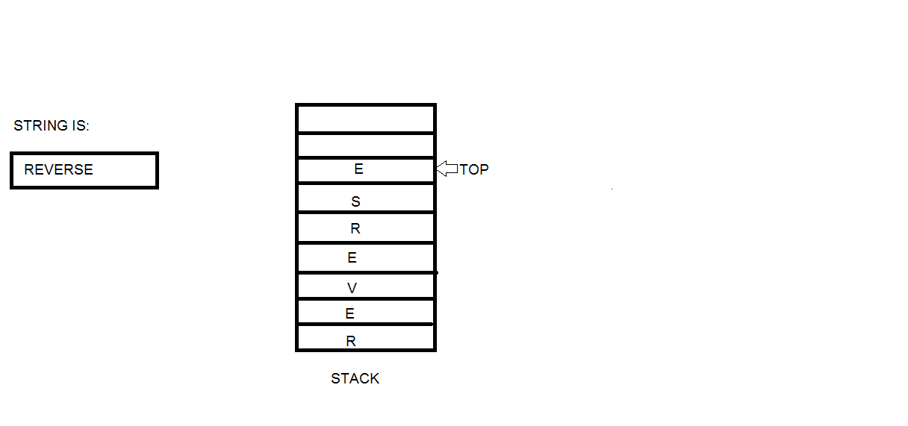
To reverse the string ‘REVERSE’ the string is read from left to right and its characters are pushed .

Slide 27
To find the longest length of balanced parenthesis
(()()()()()())
14
)()()(
4
)()()()
6

Slide 28
1) Create an empty stack and push -1 to it.
The first element of the stack is used to provide a base for the next valid string.
2) Initialize result as 0.
3) If the character is '(' , push index 'i' to the stack.
2) Else (if the character is ')')
Pop an item from the stack
If the stack is not empty, then find the length of current valid substring by taking the difference between the current index and top of the stack. If current length is more than the result, then update the result.
result=max(result,i-stack.top)
c) If the stack is empty, push the current index as a base for the next valid substring.
3) Return result.

Slide 29
((()() To find the longest length of balanced parenthesis result=max(result,i-stack.top)
INDEX | CHAR | OPERATION | STACK | RESULT
INITIALLY PUSH -1 TO STACK [-1] 0
0 | (
1 | (
2 | (
3 | )
4 | (
5 | )

